Slide 1


Title: What is happening beneath our feet?
LO: Distinguish between the characteristics of each layer of the Earth; Locate tectonic activity globally and describe the distribution of volcanoes and earthquakes
Date: Wednesday 19th August 2026
Title: What is happening beneath our feet?
What are 3 things you can recall from Year 8 humanities
Explain one reason why humanities subjects are important
Brain dump everything you already know about tectonic hazards

Slide 2
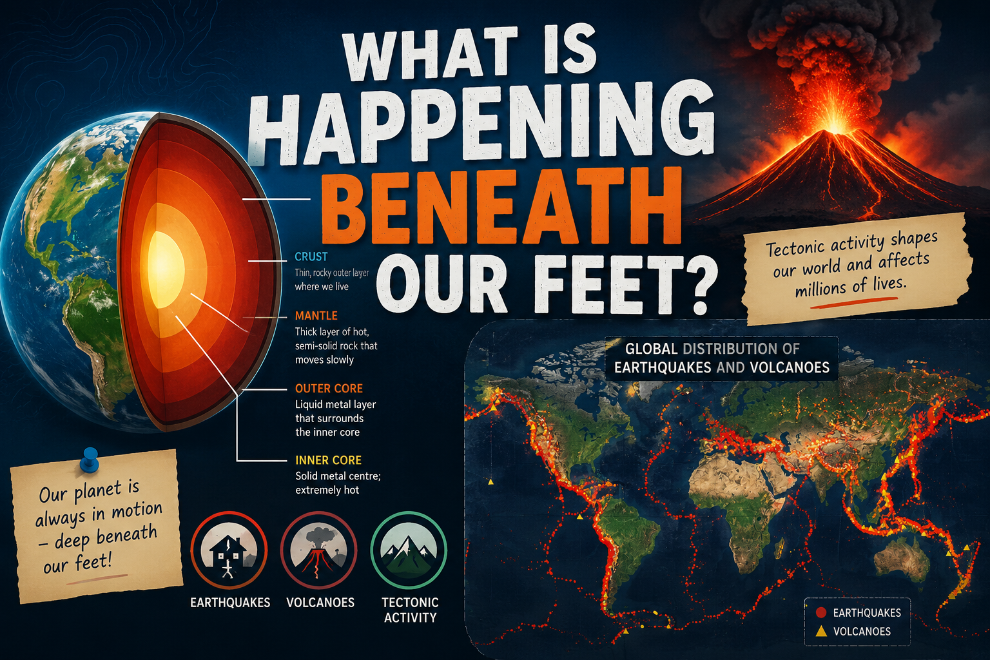
Title: What is happening beneath our feet?
LO: Distinguish between the characteristics of each layer of the Earth; Locate tectonic activity globally and describe the distribution of volcanoes and earthquakes
Success Criteria:
🌍 Meeting Can describe Earth's layers and locate earthquakes and volcanoes.
🔎 Exceeding Can compare Earth's layers and identify patterns in tectonic activity.
🧠 Mastering Can explain why tectonic activity occurs and analyse global patterns.
Key Enquiry Question:
“What is happening beneath our feet, and how does it shape the global distribution of earthquakes and volcanoes?"

Slide 3
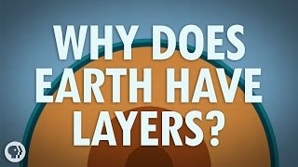
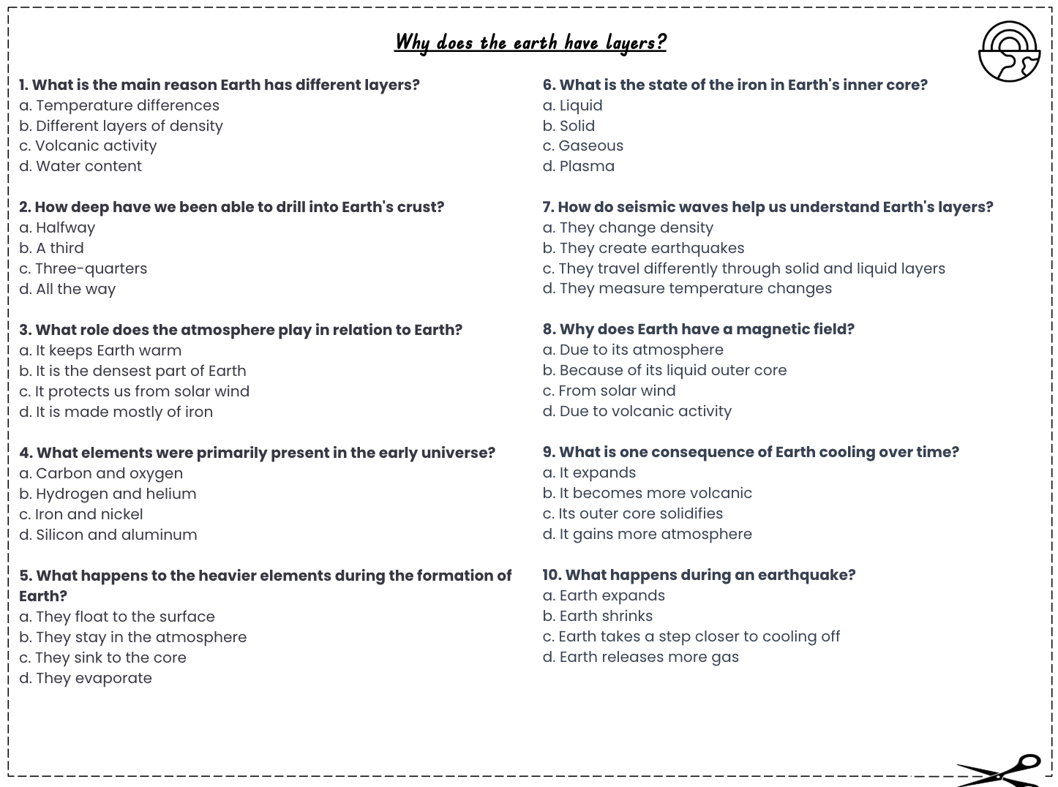
Title: What is happening beneath our feet?
LO: Distinguish between the characteristics of each layer of the Earth; Locate tectonic activity globally and describe the distribution of volcanoes and earthquakes
The Earth has layers, a bit like an onion or boiled egg. Each of these different layers has a different density, rock type and temperature.
Activity: Complete the multiple choice questions whilst watching the video on ‘Why does the earth have layers?’
Notes:
https://www.youtube.com/watch?v=WwiiOjyfvAU

Slide 4
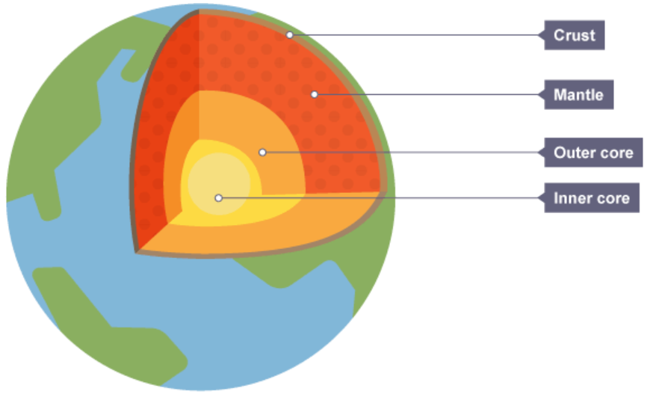
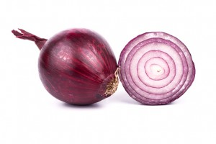

Title: What is happening beneath our feet?
LO: Distinguish between the characteristics of each layer of the Earth; Locate tectonic activity globally and describe the distribution of volcanoes and earthquakes
b. Different layers of density
b. A third
c. It protects us from solar wind
a. Hydrogen and helium
c. They sink to the core
d. Solid
d. They travel differently through solid and liquid layers
a. Because of its liquid outer core
c. Its outer core solidifies
d. Earth takes a step closer to cooling off
GREEN PEN YOUR ANSWERS

Slide 5
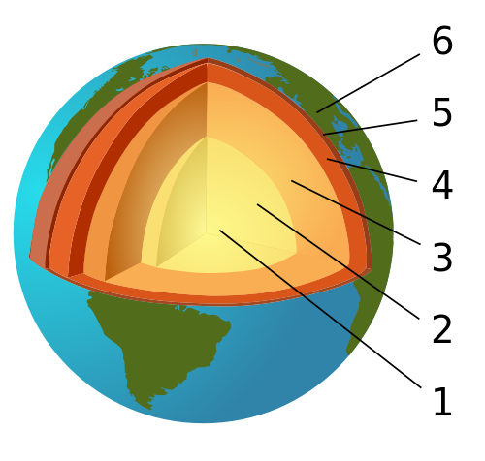
Title: What is happening beneath our feet?
LO: Distinguish between the characteristics of each layer of the Earth; Locate tectonic activity globally and describe the distribution of volcanoes and earthquakes
The structure of the Earth?
The inner core
The crust
The outer core
The mantle
Asthenosphere
Lithosphere

Slide 6
Title: What is happening beneath our feet?
LO: Distinguish between the characteristics of each layer of the Earth; Locate tectonic activity globally and describe the distribution of volcanoes and earthquakes
The structure of the Earth?
The crust
Lithosphere
Asthenosphere
The mantle
The outer core
The inner core

Slide 7
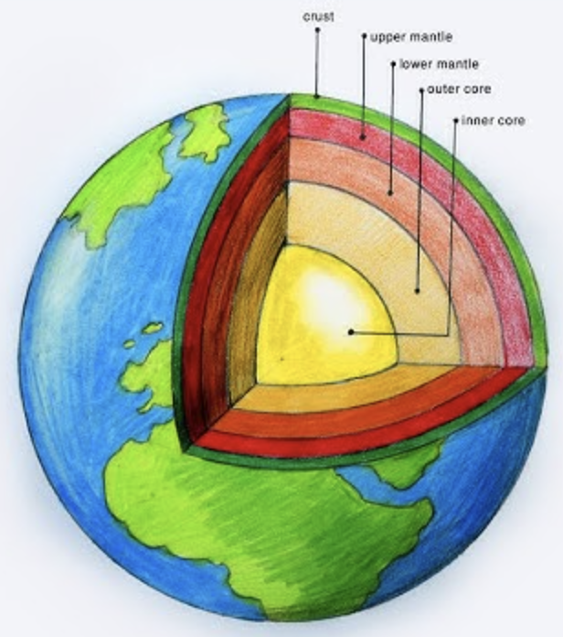
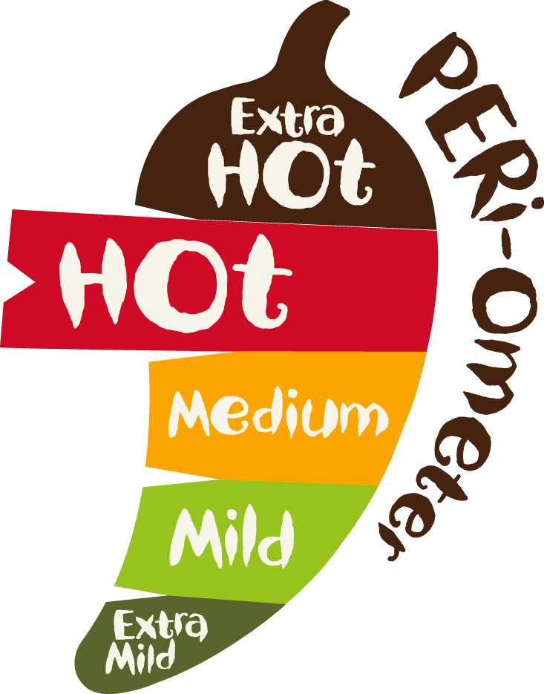
Title: What is happening beneath our feet?
LO: Distinguish between the characteristics of each layer of the Earth; Locate tectonic activity globally and describe the distribution of volcanoes and earthquakes
Activity 1: Complete the diagram to show the structure of the Earth
Activity 2:
Use the reading text to add notes to each part of the diagram. (Minimum of 2 key points)
Compare two layers of the Earth. Explain how they are different in terms of thickness, temperature, and state (solid or liquid).
Which layer do you think has the greatest influence on life on Earth? Explain and justify your choice using evidence.

Slide 8

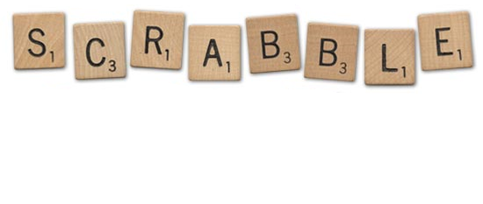
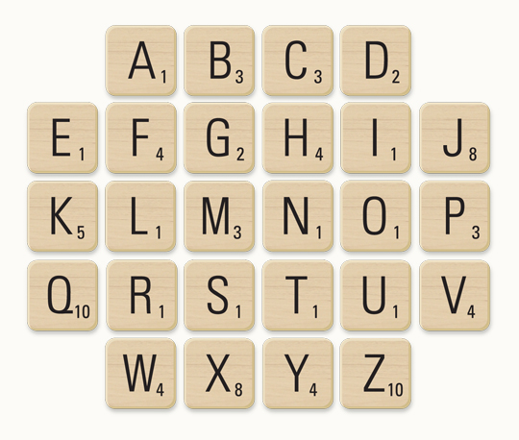
Title: What is happening beneath our feet?
LO: Distinguish between the characteristics of each layer of the Earth; Locate tectonic activity globally and describe the distribution of volcanoes and earthquakes
Activity: Scrabble
Think of a keyword or key term from today’s lesson/previous humanities lessons.
Spell it out using the scrabble tiles and add up your points.
House points if your word scores the most points from the scrabble letters.
plenary
Notes:
https://dashboard.blooket.com/set/68a6bf16f88a41401c497aae

Slide 9
Vocabulary Match-Up
Match the key term word to its’ definition.
The crust
The extremely hot, solid centre of the Earth, made mainly of iron and nickel.
Lithosphere
A softer, slowly flowing layer beneath the lithosphere that allows tectonic plates to move.
Asthenosphere
The rigid layer made up of the crust and the uppermost part of the mantle.
Mantle
A layer of liquid iron and nickel surrounding the inner core.
Outer Core
The thick layer of hot, solid rock between the crust and the outer core.
Inner Core
The thin, solid outer layer of the Earth where we live.

Slide 10
Title: What is happening beneath our feet?
LO: Distinguish between the characteristics of each layer of the Earth; Locate tectonic activity globally and describe the distribution of volcanoes and earthquakes
Success Criteria:
🌍 Meeting Can describe Earth's layers and locate earthquakes and volcanoes.
🔎 Exceeding Can compare Earth's layers and identify patterns in tectonic activity.
🧠 Mastering Can explain why tectonic activity occurs and analyse global patterns.
Key Enquiry Question:
“What is happening beneath our feet, and how does it shape the global distribution of earthquakes and volcanoes?"

Slide 11
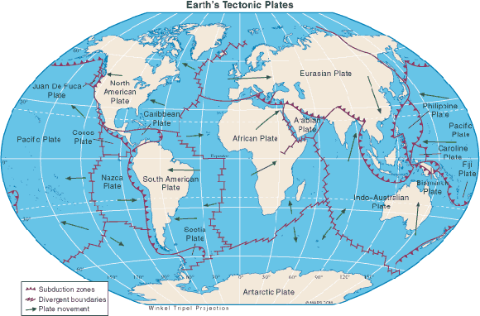
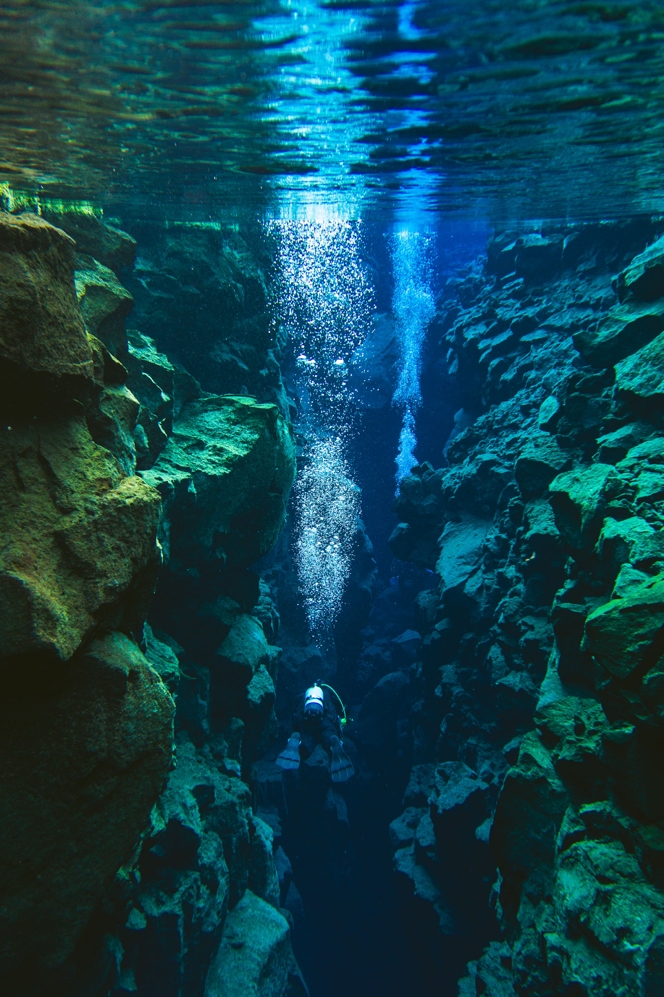
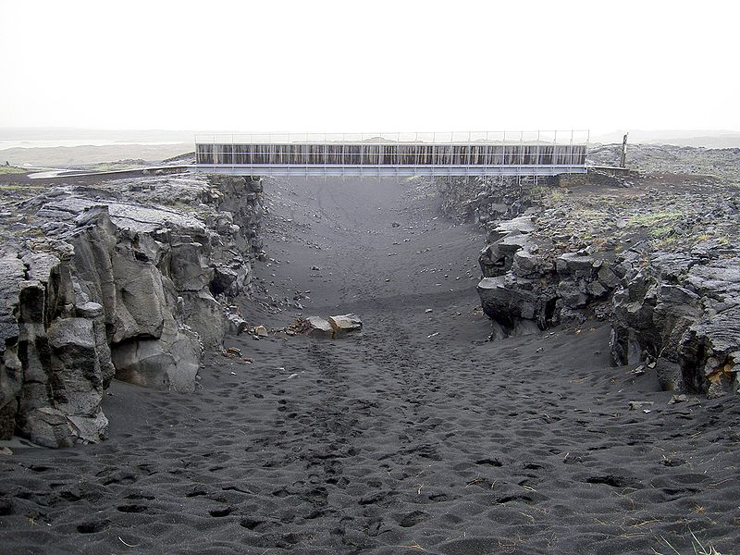
Title: What is happening beneath our feet?
LO: Distinguish between the characteristics of each layer of the Earth; Locate tectonic activity globally and describe the distribution of volcanoes and earthquakes
The Earth’s crust comes in two types: oceanic crust and continental crust.
Oceanic crust is thinner, heavier, and made mostly of dark rock like basalt. It lies under the oceans.
Continental crust is thicker, lighter, and made of lighter rocks like granite. It forms the land we live on.
The Earth’s crust is not one solid shell. Instead, it is cracked into huge pieces, a bit like the shell of a broken egg. These pieces are called tectonic plates. They fit together like a jigsaw puzzle and slowly move around on the softer layer beneath.
Oceanic crust
Continental crust

Slide 12
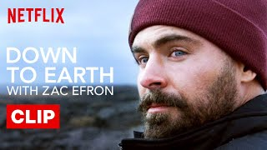

Slide 13

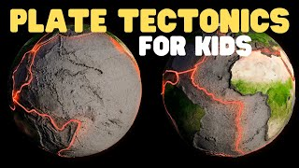


Title: What is happening beneath our feet?
LO: Distinguish between the characteristics of each layer of the Earth; Locate tectonic activity globally and describe the distribution of volcanoes and earthquakes
↔️ Plate Tectonics
True Or False
The lithosphere is made up of the Earth's crust and part of the upper mantle.
Tectonic plates move quickly enough for people to feel them moving every day.
At a convergent boundary, two tectonic plates move towards each other.
At a divergent boundary, tectonic plates move away from each other.
Pangaea was a giant landmass that existed more than 250 million years ago.
Notes:
https://www.youtube.com/watch?v=bVn04eJRjV4

Slide 14
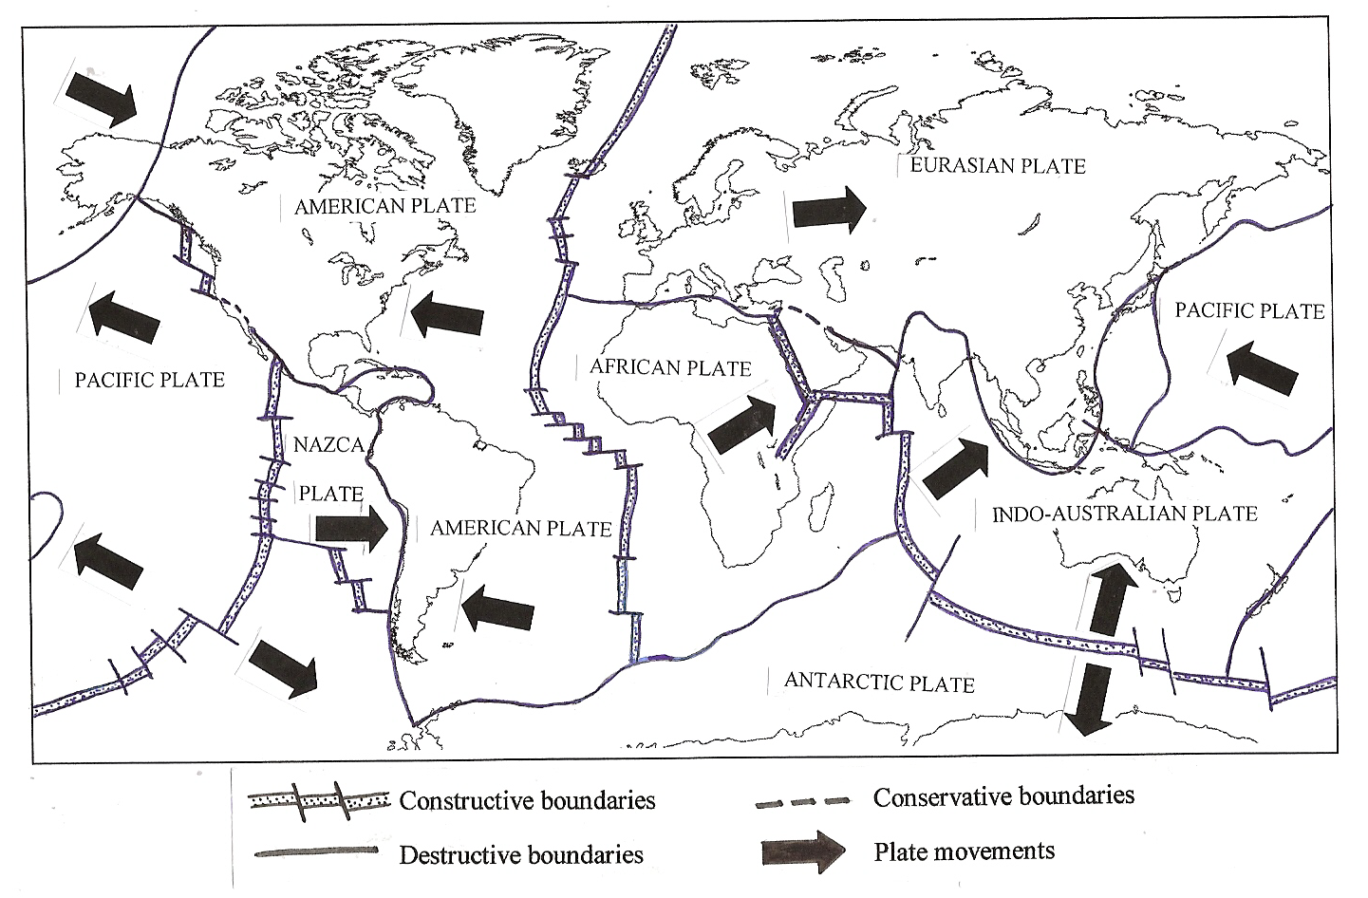
Title: What is happening beneath our feet?
LO: Distinguish between the characteristics of each layer of the Earth; Locate tectonic activity globally and describe the distribution of volcanoes and earthquakes
Activity: Use your map to help you answer the following questions:
Which tectonic plate is Malaysia located on?
Which tectonic plate is India located on?
Which direction is the African Plate moving?
Which direction is the Antarctic Plate moving?
Which direction is the Nazca Plate moving?
What type of plate boundary is found in the middle of the Atlantic Ocean?
How are the plates moving at this boundary?
What type of plate boundary is found between the Nazca Plate and South American Plate?
How are the plates moving at this boundary?
How do plates move at a conservative plate boundary?
Why are there very few earthquakes and no volcanoes in Peninsular Malaysia?
Use an atlas to find the Atlantic Ocean. There is a plate boundary that runs north to south in the middle of the ocean. Name the feature of the ocean floor that forms this boundary. Use Map C to name the four plates found either side of this boundary
Is Africa moving towards or away from South America?
Design a new tectonic plate! Draw and label:
🗺️ Its location
➡️ Direction of movement
🔀 Type of boundary
🌋 One hazard it could cause
⭐ Give your plate a name!

Slide 15


Title: What is happening beneath our feet?
LO: Distinguish between the characteristics of each layer of the Earth; Locate tectonic activity globally and describe the distribution of volcanoes and earthquakes
Activity: Use your map to help you answer the following questions:
Which tectonic plate is Malaysia located on?
Which tectonic plate is India located on?
Which direction is the African Plate moving?
Which direction is the Antarctic Plate moving?
Which direction is the Nazca Plate moving?
What type of plate boundary is found in the middle of the Atlantic Ocean?
How are the plates moving at this boundary?
What type of plate boundary is found between the Nazca Plate and South American Plate?
How are the plates moving at this boundary?
How do plates move at a conservative plate boundary?
Why are there very few earthquakes and no volcanoes in Peninsular Malaysia?
Design a new tectonic plate! Draw and label:
🗺️ Its location
➡️ Direction of movement
🔀 Type of boundary
🌋 One hazard it could cause
⭐ Give your plate a name!
Notes:
https://www.youtube.com/watch?v=r3OER89bTlk

Slide 16

Title: What is happening beneath our feet?
LO: Distinguish between the characteristics of each layer of the Earth; Locate tectonic activity globally and describe the distribution of volcanoes and earthquakes
Activity: Use your map to help you answer the following questions:
Eurasian Plate
Indo-Australian Plate
North-East
South
East
Constructive boundary
Moving apart from each other
Destructive boundary
Moving toward each other
Sliding past each other horizontally
It is located far from active plate boundaries, near the middle of the Eurasian Plate.

Slide 17
Title: What is happening beneath our feet?
LO: Distinguish between the characteristics of each layer of the Earth; Locate tectonic activity globally and describe the distribution of volcanoes and earthquakes
Activity: Scrabble
Think of a keyword or key term from today’s lesson/previous humanities lessons.
Spell it out using the scrabble tiles and add up your points.
House points if your word scores the most points from the scrabble letters.
plenary
Notes:
https://dashboard.blooket.com/set/68a6bf16f88a41401c497aae

